Slide 1
UBCA EXECUTIVE REPORT 2020
Presented By:
GEOFFREY NSEREKO – Chairman
HENRY MUKASA – Treasurer
JULIE NAJJUMBA - Education Affairs
PROSSCOVIA NASSOZI - Women Affairs

Slide 2
REPORT CONTENTS
CHAIRMAN’S REPORT
TREASURER’S REPORT
EDUCATION DEPARTMENT REPORT
WOMEN AFFAIR’S REPORT

Slide 3
CHAIRMAN’S REPORT
BY : GEOFFREY NSEREKO ( SIMPLE )

Slide 4
THE YEAR 2020
UBCA 2020 CALENDER
THE COVID-19 PANDEMIC
UBCA ACHIVEMENTS
CHALLENGES
WAY FORWARD
UBCA MEMBERSHIP

Slide 5
UBCA 2020 CALENDER
FEBRAURY- Education day
March - Women’s Day
May -Immigration Day
/ Health Day
Boston Day
August – Annual General Meeting

Slide 6
UBCA Education Day 2020
UBCA organized the education forum
Discussed Homework support for our children
Career Guidance
Drug abuse by our kids
Adult Education
Both Parents and children attended

Slide 7
INTERNATIONAL Women’s DAY Celebrations
Awarding of outstanding women in our community
Women shared experiences
Men entertained , prepared and served lunch
Community sponsored the function
Businesses in our community offered services at a little pay or for free
and more……….

Slide 8
THE COVID-19 PANDEMIC
Community was impacted a great deal
Many lost jobs others had reduced working hours
Schools closure impacted a lot of working parents
Many struggled with food, Rent , and home cleaning supplies
PPE were in scarce
Many depressed and stressed with the unknown
We lost many Community Members to COVID-19

Slide 9
UBCA COMMUNITY COVID-19 COMMUNICATION

Slide 10
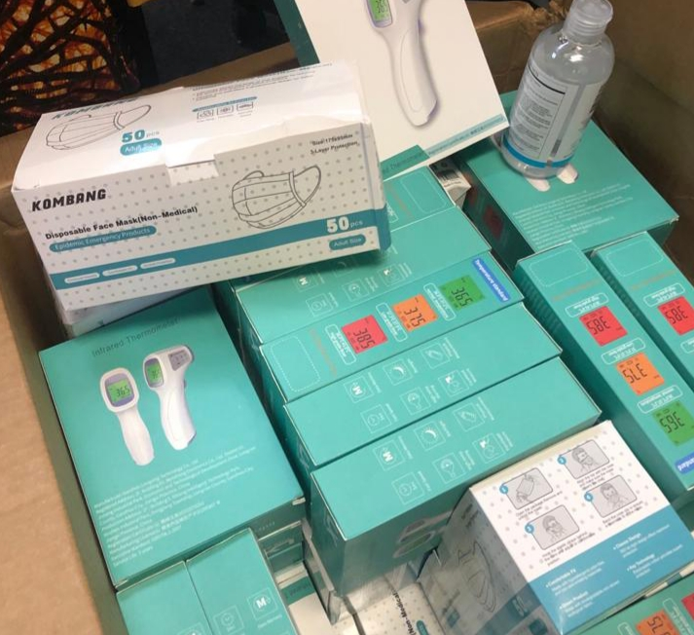
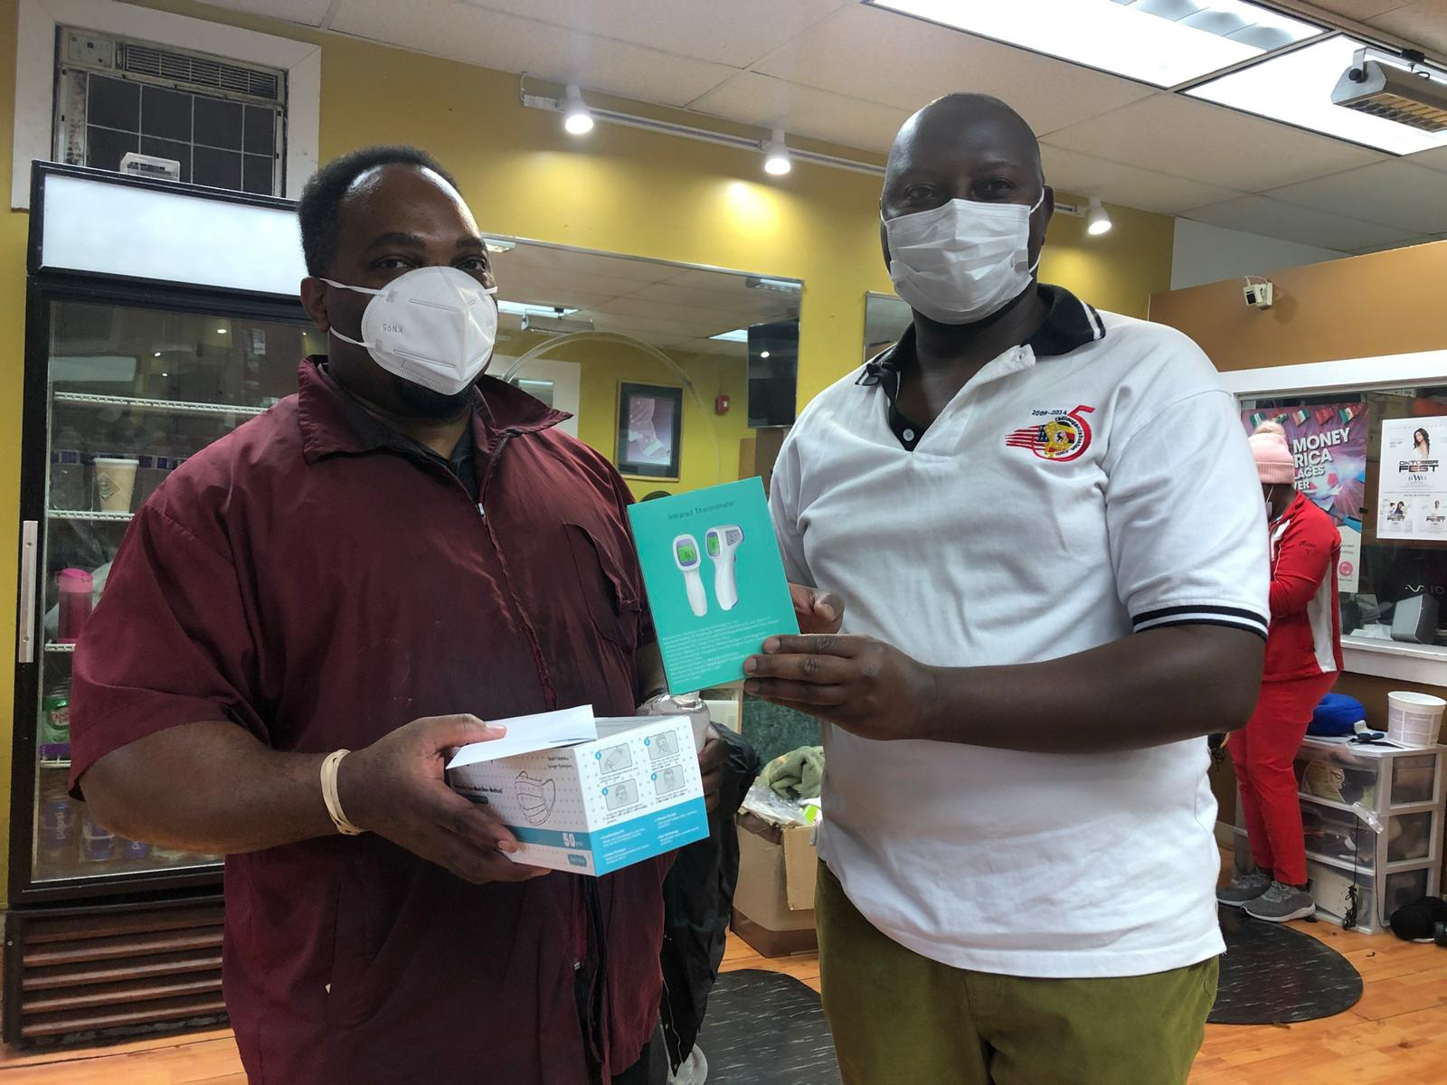
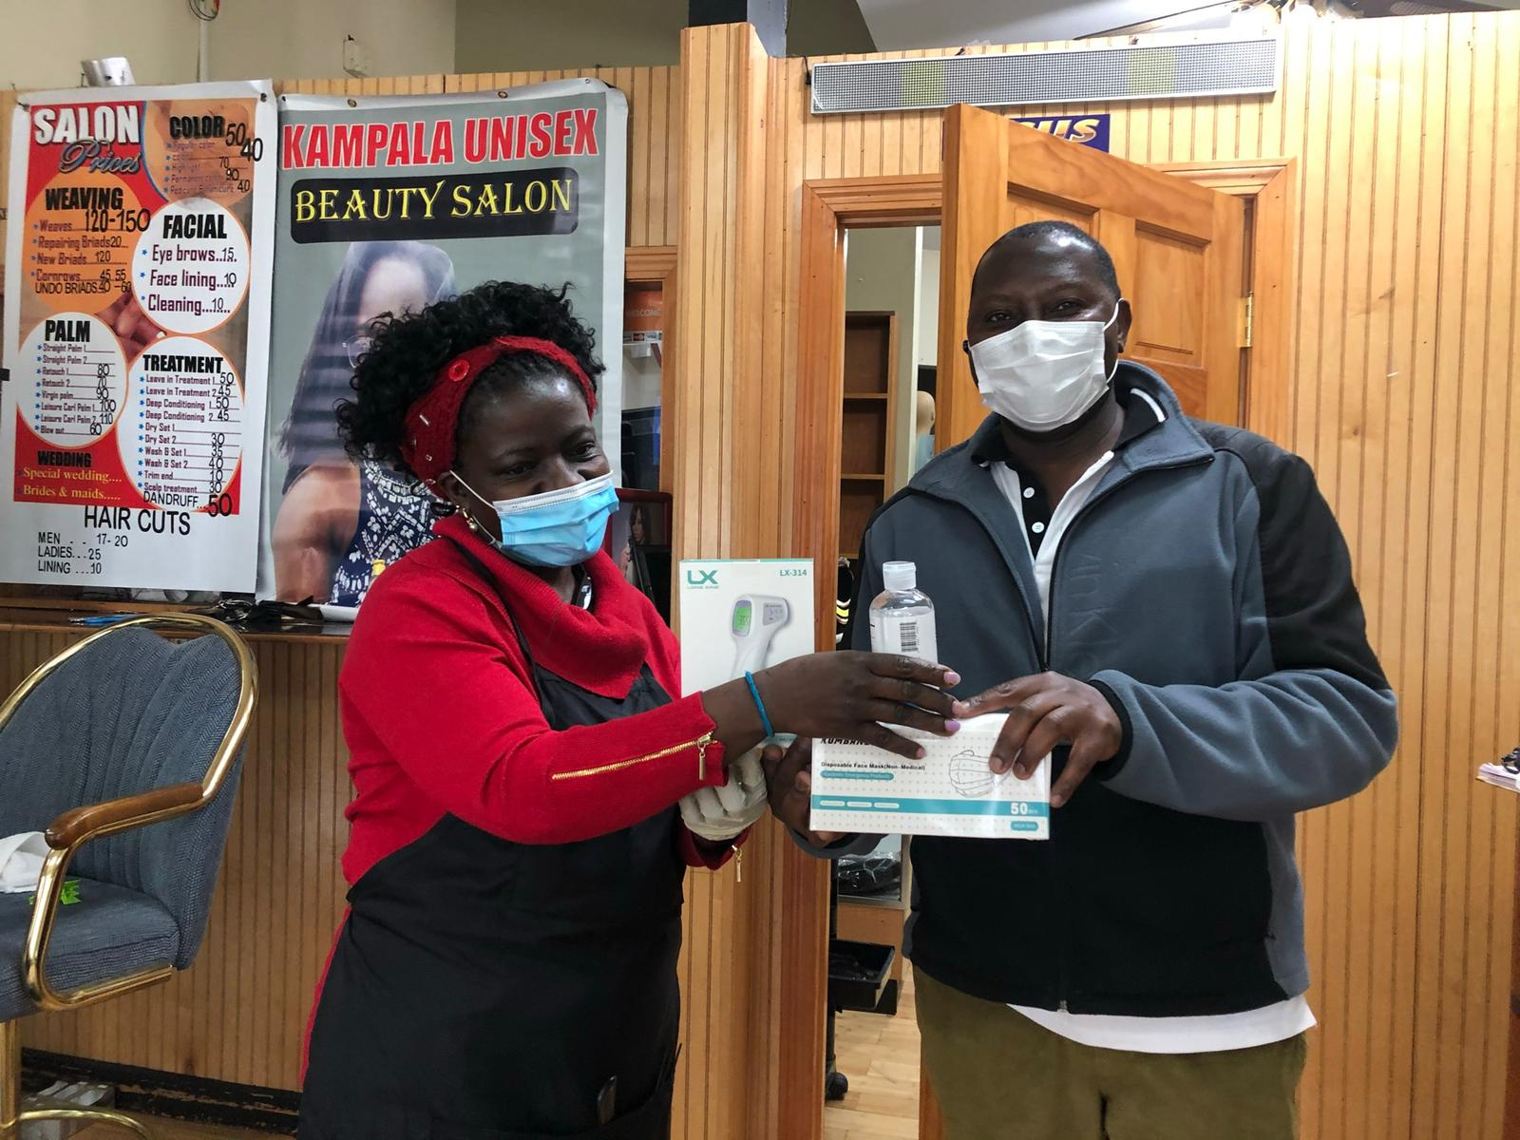
UBCA WELLNESS PACKAGES
A non-contact Thermometer (Temperature Gun)
1 box of surgical masks
I bottle of hand sanitizer.

Slide 11
UBCA WELLNES PACKAGES RECIPIENTS
Friends Salon (Douglas)
Kampala Unisex (Mildred)
Sule’s Saloon
Karibu Restaurant
Club Rendezvous
Africano
Waltham Mosque
St. Mary's Catholic
St. Paul, Waltham
All Saints, Newton
Radio Uganda Boston
Pearl of Africa Store
More to Receive or Pick up …….

Slide 12
UBCA MEMBERSHIP
Membership fee is $50 a year
Membership fee is used to run the day today activities of the Association
$10 of the $50 goes to the UBCA Building Project Account
Membership is Renewal is year around

Slide 13
UBCA 2020 SUCCESSES
Much as 2020 was a very stressful year, UBCA managed to register some success in different things.
EDUCATION FORUM
INTERNATIONAL WOMEN’S DAY
UBCA organized a successful Education forum which was attended by both Parents and Children.
The turn up was not great that day , we had lost a community member .
Those who attended benefited a lot.
Thanks to Africano for the organization and collaboration
UBCA also managed to organize a successful women’s day on March 8th.
Attended to over capacity of the Hall .we were almost kicked out of the Hall because of we exceeded the capacity
Community members sponsored the function

Slide 14
UBCA 2020 SUCCESSES Cont.
EDUCATION FORUM
International Women's Day
UBCA organized a successful Education forum which was attended by both Parents and Children.
The turn up was not great that day , we had lost a community member .
Those who attended benefited a lot.
Thanks to Africano for the organization and collaboration
UBCA also managed to organize a successful women’s day on March 8th.
Attended to over capacity of the Hall .we were almost kicked out of the Hall because of we exceeded the capacity
Community members sponsored the function

Slide 15
DONATIONS & GRANTS TO UBCA
UBCA reached out to different organizations seeking for help.
UBCA received a grant from Boston Foundation - $25,000
UBCA received a grant from Weston Cares - $5,000 . Specifically help people of Waltham and Weston with their Rent issues.
Many people benefited and are still benefitting from the two program.
A comprehensive report on how we used this money will be given out.
Several Community Members donated household supplies and cash to help members affected by COVID-19.

Slide 16
UBCA BUILDING PROJECT ACCOUNT
The Executive decided to kick off the project for our building by taking off $10 from each paid member.
We opened a “Savings Account” for the project with Citizens bank. The treasurer will give details .

Slide 17
UBCA COVID-19 TASK FORCE AND EMERGENCY COMMITTEE FORMATION
During the pandemic , we formed up the 2 committees.
The task force is responsible for reaching out to community members who are sick ,bring them food, asses their situation and needs.
The task Force reports directly to UBCA executive and it comprises of 13 members.
The Emergence committee is composed of all Religious and community members for moral support.
The Task force has a member responsible for community members who are in prisons; Ms. Rosettee Sserwanga.

Slide 18
UBCA 2020 SUCCESSES Cont.
LAPTOP After our swearing in UBCA bought its first Laptop .Its in the custody of the secretary.
ZOOM ACCOUNT UBCA secured a zoom account for our online meetings since this the way forward during COVID-19 times
Recognition as Community Association
An Increase in the number of community members seeking letters of support.
These letters are needed especially in courts of law for immigration and other legal matters .
UBCA has enjoyed a good reputation. If you need a supporting letter ,it takes a few days.

Slide 19
UBCA 2020 SUCCESSES Cont.
UBCA PRESENCE
Our presence and publicity has been felt in others states .
Other States keep asking us how we do the organization and fundraising and keep together as a community and taking notes .
We are a perfect model as the best organized Ugandan Diaspora Association.

Slide 20
CHALLENGES
A few elements in the community have continued to spread wrong information about UBCA .
Their motive is NEVER known.
At the beginning of the year there were Audios making rounds on social media about the chairman , the Executive together with the COVID Emergency task force .
This created some confusion in our community.
This impacted the progress of the Association.
Many Community Members won't subscribe to the Association but need the help.

Slide 21
WAY FORWARD
Encourage all Ugandans in Massachusetts to be fully registered members of the Association.
1
Put more emphasis on having the youth and the young Adults join. They're the future of the Association.
2
Do More networking for more friendships , scholarships for our children and grants to financing the Association's projects.
3
Promote the Association instead of bad mouthing it. We miss out on a lot by being against each other.
4

Slide 22
WAY FORWARD Cont.
Continue with more progressive programs for the community especially , continuing with our mission and objectives: Bringing Ugandans together with developmental goals and Acquiring our own building as Ugandans in Massachusetts.
We are considering a singles dinner as it has been requested by many of our single community members searching for partners.
Remember, Togetherness is the reason for our bonding. There is no Limit to our togetherness as a Community.

Slide 23
Treasurer’s Report
By HENRY MUKASA

Slide 24
Where UBCA Gets Its Finances;
Membership - Annual fees collected from members .
01
Community Fundraising - Community members contribute funds to a given UBCA cause.
02
Donations or Grants - From foundations that offer financial help to community Associations like ours.
03

Slide 25
UBCA Annual Membership
Annual Fee - $50.00
So far, a few Members have renewed their membership
$10 of the $50 is subtracted from membership
Its saved on the UBCA Building Project Account - $ 640
Total Membership collection 2020 -2021 is $3,250

Slide 26
Community Contributions & Fundraising
Community fundraised funds used to organize the Women's Day Celebrations 2020 .
Community contributed and fundraised for the COVID-19 Community Outreach
Community donated cash, food and essential household supplies,
A total of 112 donors, mostly from the Ugandan Community in Massachusetts as well as from friends and well-wishers.
The UBCA COVID-19 Task force received a total of $8,199 in cash donations
$3,512 was handed out in cash assistance
$1,667.00 was reimbursements
Food and essential supplies bought

Slide 27
Community Fundraising Cont.
Many families received food and essential household supplies .
Many individuals who had contracted COVID-19 received an immune and energy booster juice mixture supplied by Mr. and Mrs. Ssebakka (WOPI) to help them manage their situation.
Hot meals were donated by Club Rendezvous and the Waltham Islamic Society in collaboration with UMMATI Foundation, Inc.
31 masks that were donated by Health Action for Ugandans (HAFU).
Thanks, to the dedicated volunteers including the efforts of members of the Taskforce Committee
Special Thanks to of Mr. Ismail Nasser Kasirye of Pearl of Africa Store who gave up space in his store for storage of food and essential supplies.

Slide 28
GRANTS
Limited to Weston and Waltham Residents.
Only to Help those struggling with Rent
Grant Total Amount | $5,000
No. of Recipients | 10
$ Per Recipient | $500.00
Expenditure | $5,000
Balance Total | $0.000

Slide 29
Grant Cont.
Used to assist with arears on utilities
Assist with household supplies and food
Uses to procure some PPE
Boston Grant Total | $25,000.00
Expenditure | $13,736.85
Balance Total | $11,263.15

Slide 30
Grants Cont.
THE BOSTON FOUNDATION GRANT SPENDING | AMOUNT
Cash Assistance for Food/Home Supplies | $ 4,950
Cash Assistance for Utility Bills | $ 6,587
Counseling Services | $ 900
Social Media Advert | $ 200
Radio Uganda Boston Online Radio Promo | $ 600
Diaspora TV Community Education Program | $ 200
Home Remedy Immunity Juice Ingredients | $ 300
TOTAL | $ 13,737

Slide 32
Items That UBCA Spends Money on
Community Outreach –Food, Household supplies
,utility bill payments , PPEs
Office Supplies ( Paper , Envelopes , Printer Ink )
WEBSITE Maintenance
Information Sharing ( Sensitization )
Community Forums

Slide 33
Other Items UBCA Spends Money on Cont.
Laptop | $700
Software | $150 Annual
Website Maintenance | $30@Month
Zoom Account | $ 200
Wellness Packages for Places of Worship $ Businesses | $1.199.70

Slide 34
UBCA Account
ITEM | AMMOUNT
Boston Grant | $11,263.15
Member ship Collected | $3,250.00
UBCA Building Project Savings (subtracted from the membership total) | $ 640.00
Thank you . Happy Holidays

Slide 35
EDUCATION REPORT
By MS. Julie Najjumba

Slide 36
Education Forum
Education session in February 2020
Various topics covered like drug abuse, college preparation
Various youth attended
Some Parents attended too

Slide 37
More From Education Department
Various Educational Session possibilities Via Zoom
Sessions include College Prep
One on one homework help for youth
Book Club and General Education Advising

Slide 38
CHALLENGES
Parents’ Failure to be involved in these educational sessions for their youth.
Very Busy Parents Coupled with communication is poor.
Some Youth are struggling and need help

Slide 39
Recommendations
we should remind them that they need Help.
Parents Improve communication with their children and their teachers .
Parents should support these students because they are the leaders of tomorrow.
Thank you !

Slide 40
Women Affairs Report
By: Ms. Prosscovia Nassozi

Slide 41
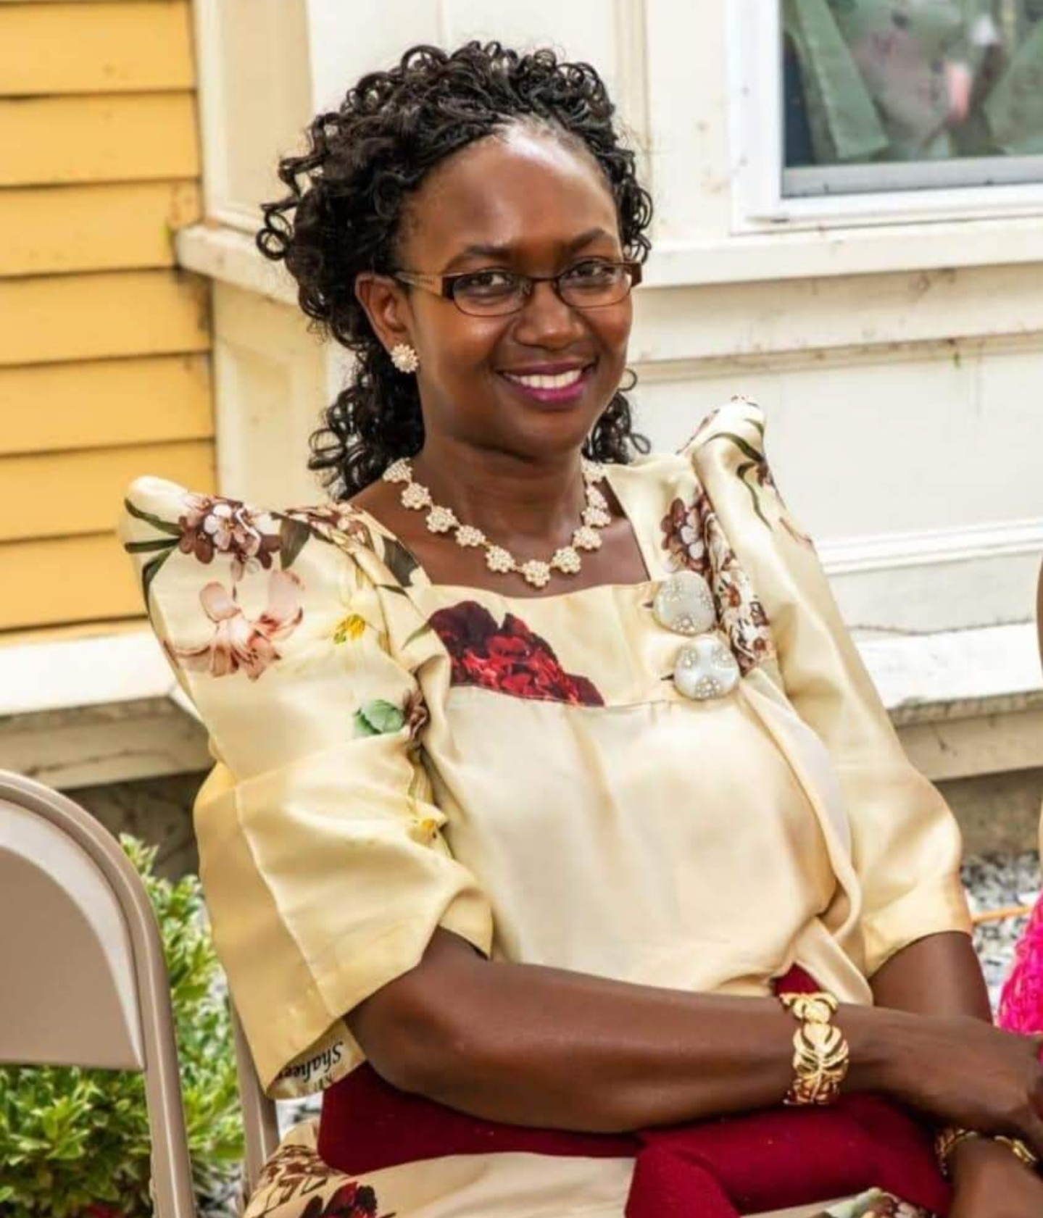
Remembering Community Members, We’ve Lost in 2020
Darius Ndahiro
JOSEPH MUTYABA

Slide 42
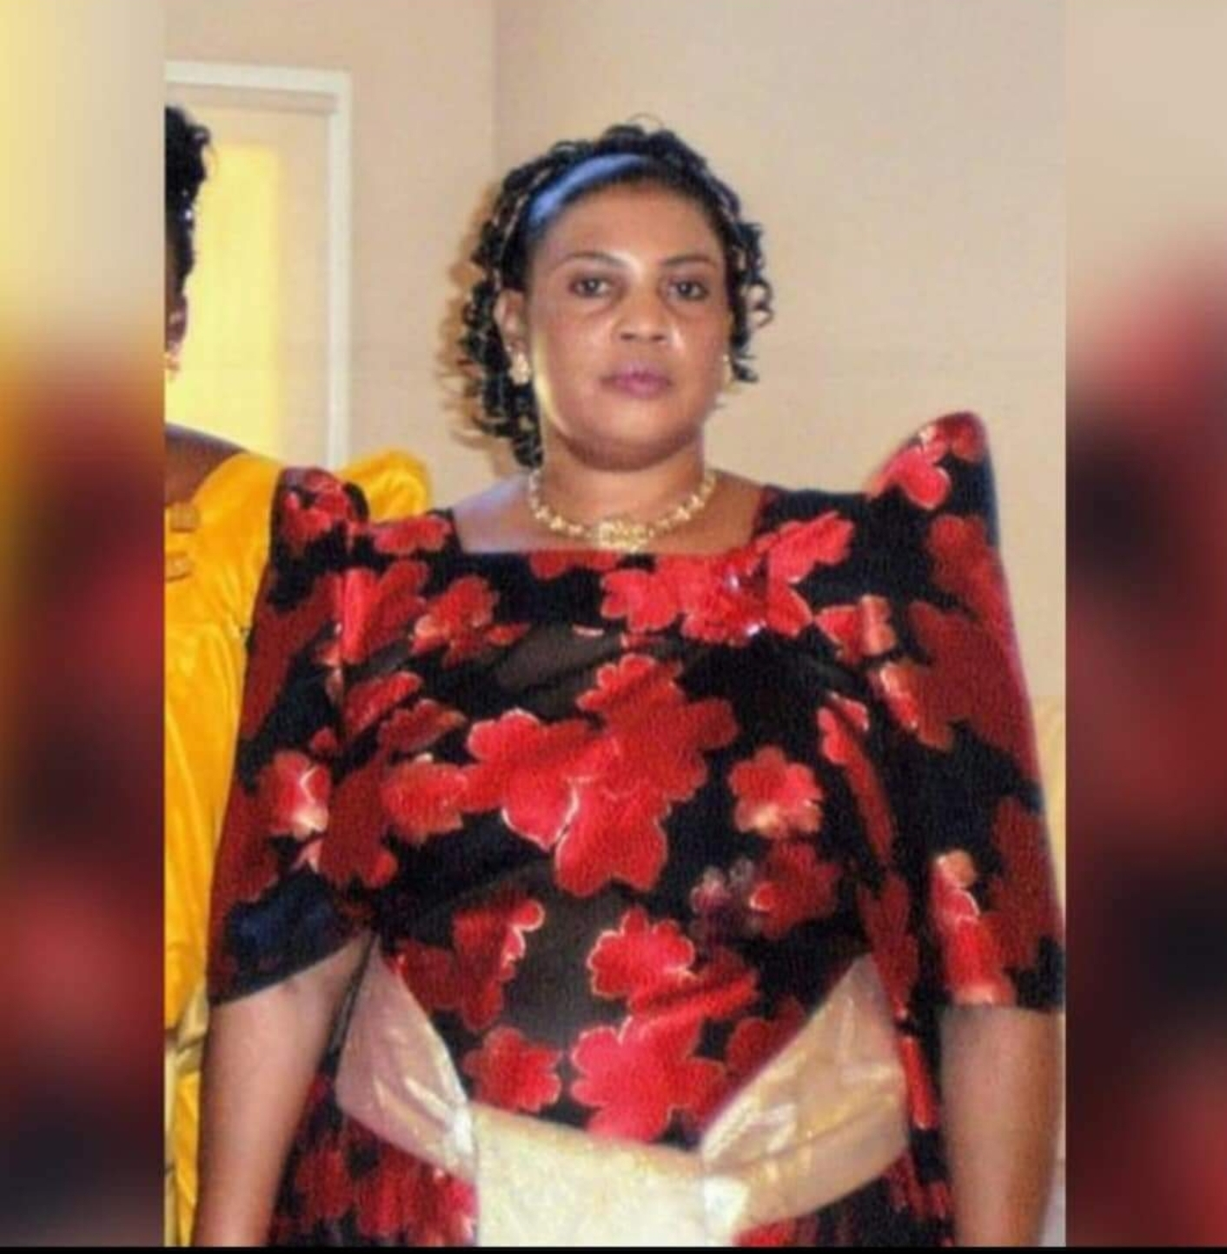
Remembering Community Members, We’ve Lost in 2020 Cont.

Slide 43
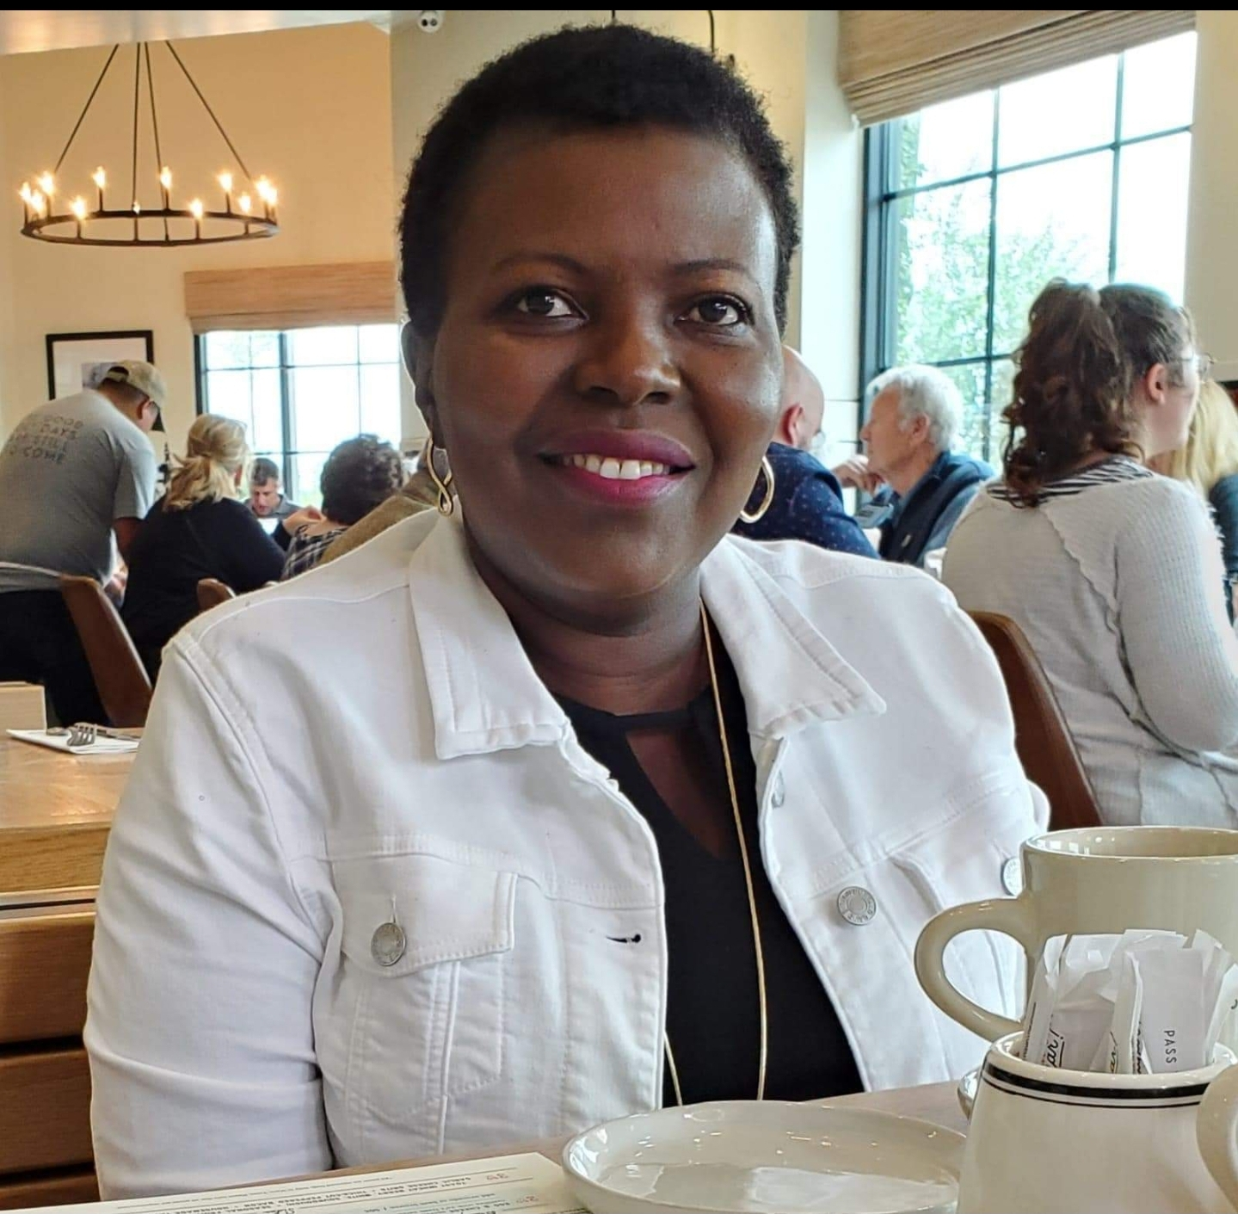
Remembering Community Members, We’ve Lost in 2020 Cont.
GLORIA
HARRIET ZALWANGO

Slide 44
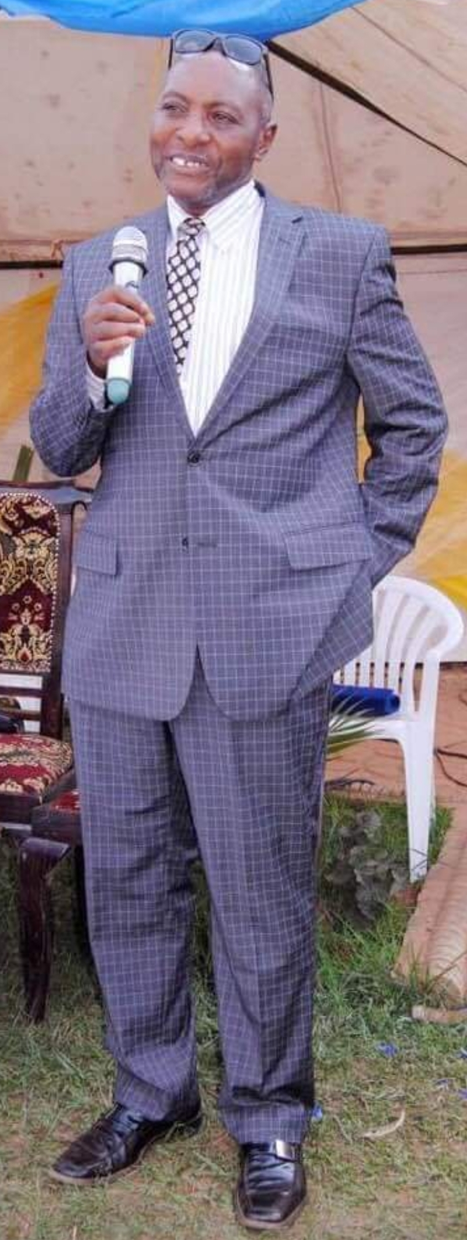
Remembering Community Members, We’ve Lost in 2020 Cont.
DENNIS DENHAM SSEMPEREZA
HENRY NABUGWAMU

Slide 45
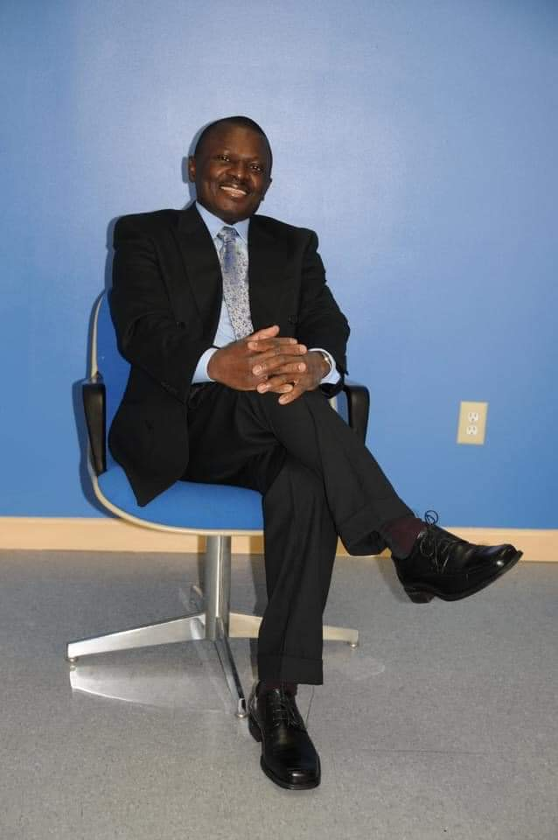
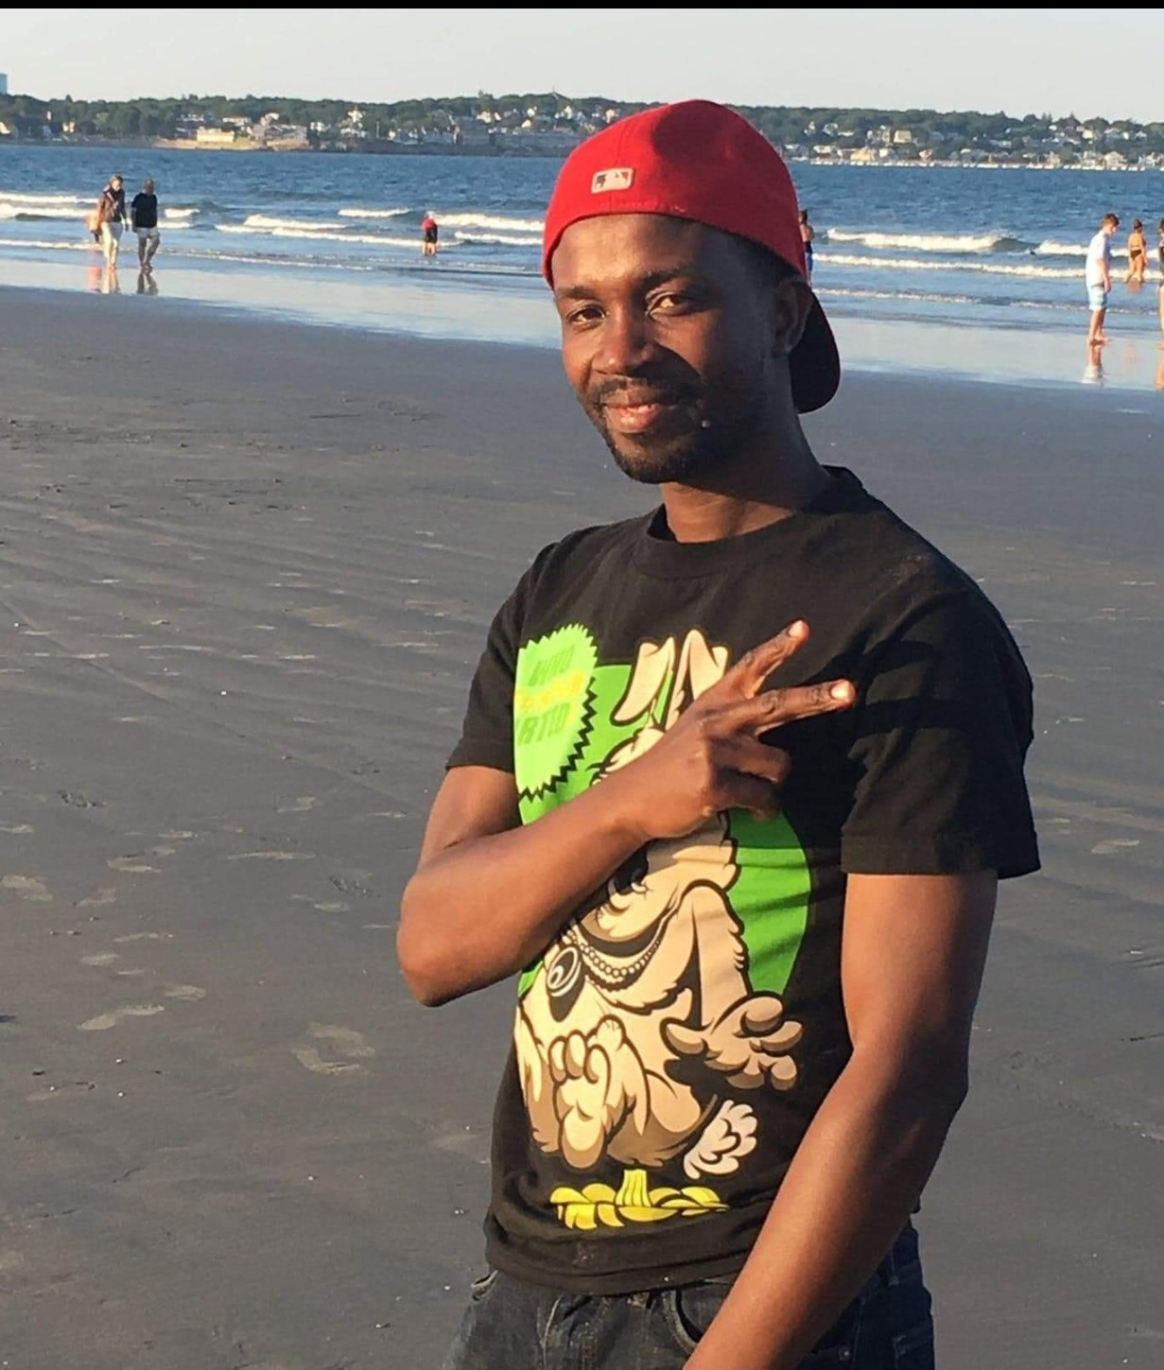
Remembering Community Members, Who passed in 2020
PROSSY- Sisters Saloon
LUKOMWA NSUBUGA GRACE
May their souls rest in forever perfect peace And Their memory always be a blessing .

Slide 46
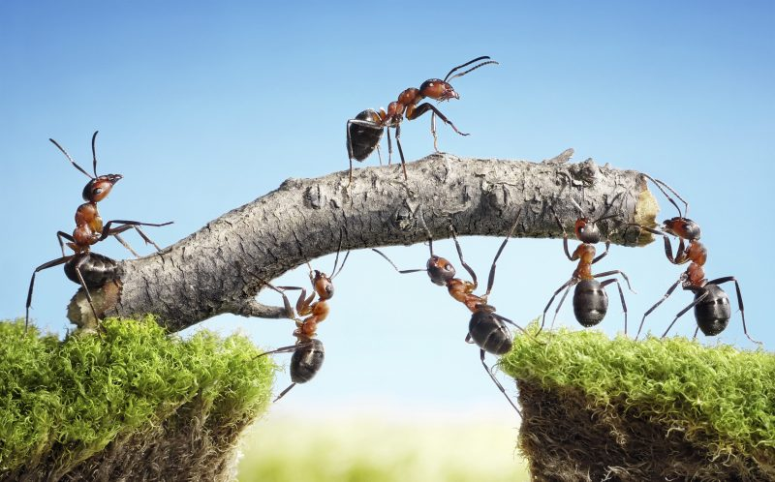
“Alone, we can do so little; together, we can do so much” – Helen Keller
Photo Source : https://www.catersnews.com

Slide 47
Address : 57 Washington Street Apt.4 Medford MA 02155
Website : www.ubca2013.org
Email: info@ubca2013.org
General Line : 617-650-0729
UBCA Helpline: 508-468-1406

